Slide 1

Stock Data Analysis App
By Can Lin

Slide 2
Main Features
Stock chart in candle sticks and lines.
MACD indicators.
Financial information about the inputted stock ticker.

Slide 3
Reasons that I chose to design this project
Enlightened by the instructor – Dr. Yu.
Recently gained interests into stock trading.
A good project to develop for the long term.
Not all the stock apps are free in the market.
The number of stock app subscribers increased significantly in 2020.
After the completion of the app, it could be sold for a profit.

Slide 4
The process…
Story Board.
Auto-layout.
Looking for the best data source api that I can find from the internet.
Fetch and parse the stock data from Yahoo finance api and other api
Dispatch and load the data into the stock chart.
Find macd data.
Fetch and parse the stock macd data.
Finding the right chart library.
Loading data into charts.

Slide 5
Challenges or problems that I encountered
Unwrapping optional data types can be tricky in Swift.
Finding the data source that is appropriate and free.
Finding the correct chart library and learning how to adjust data to show in the stock chart.
Switching from a line chart to a candle stick chart.
Turning on and off the MACD indicators.

Slide 6
Things I learned from the project
Asking questions and seeking helps from the instructor and Stack overflow.
Xcode programming environment.
How to fetch and read data from different api.
How to use the chart library

Slide 7
MVC design pattern
Model
API
Util
View
Input View
Home View
Analysis View
Controller
InputViewController
HomeViewController
AnalysisController

Slide 8
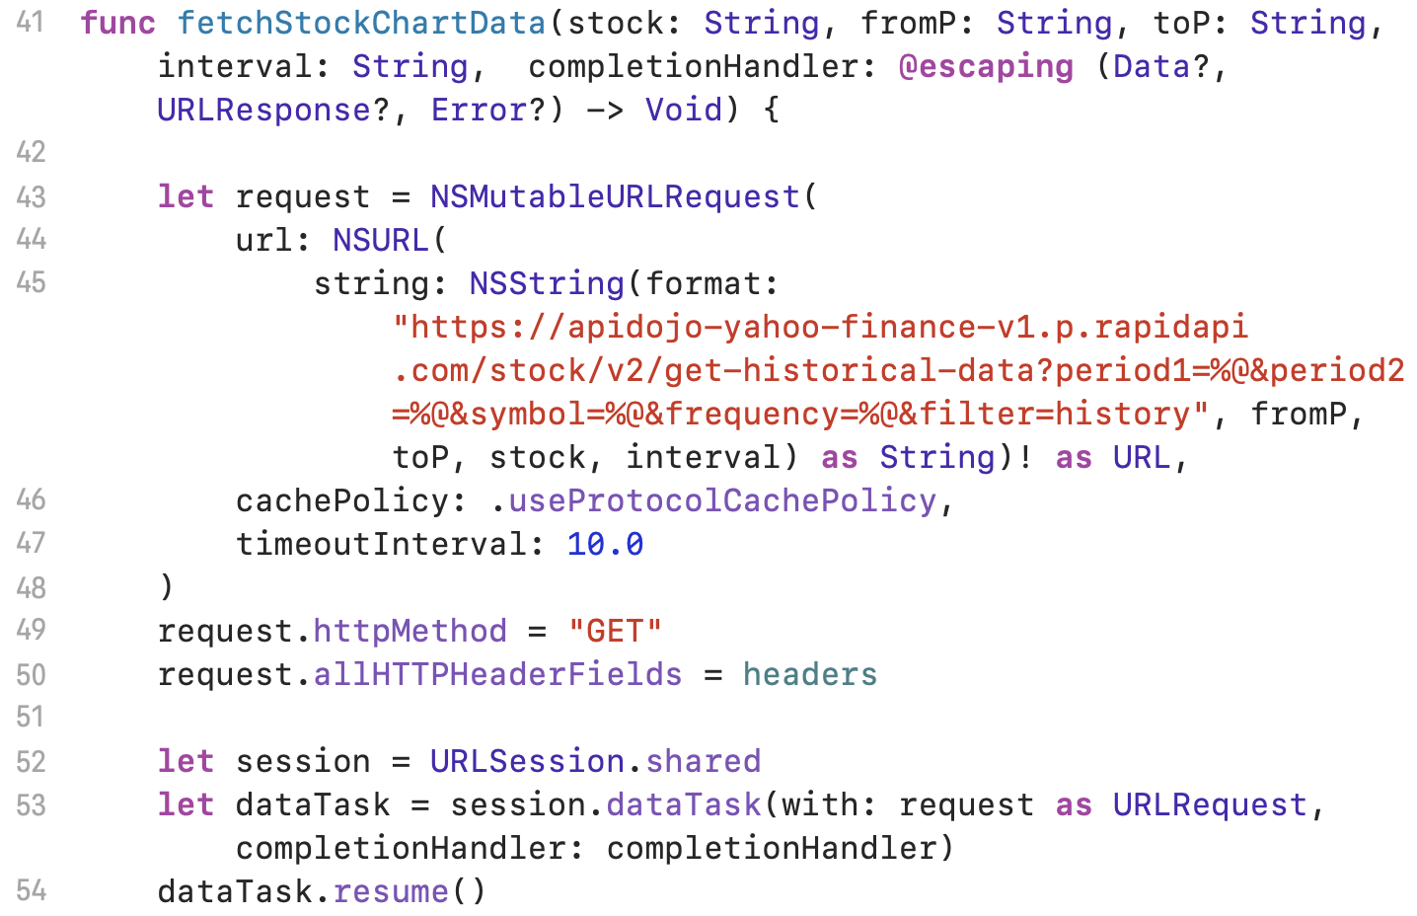
API
Fetching Chart data from Yahoo Finance

Slide 9
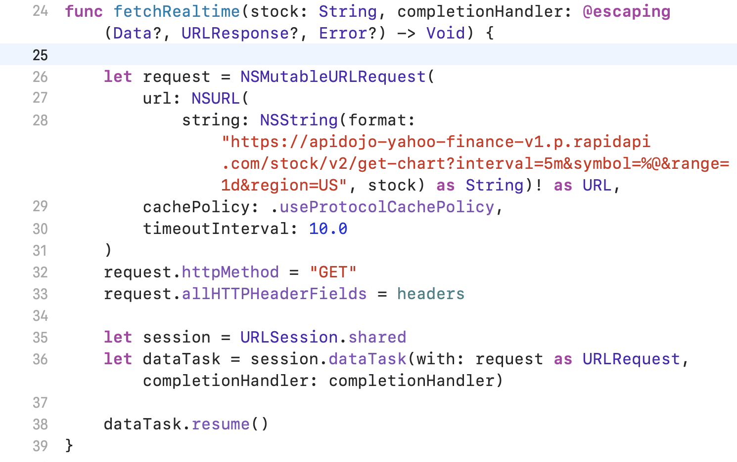
API
Fetching real time data from Yahoo Finance

Slide 10
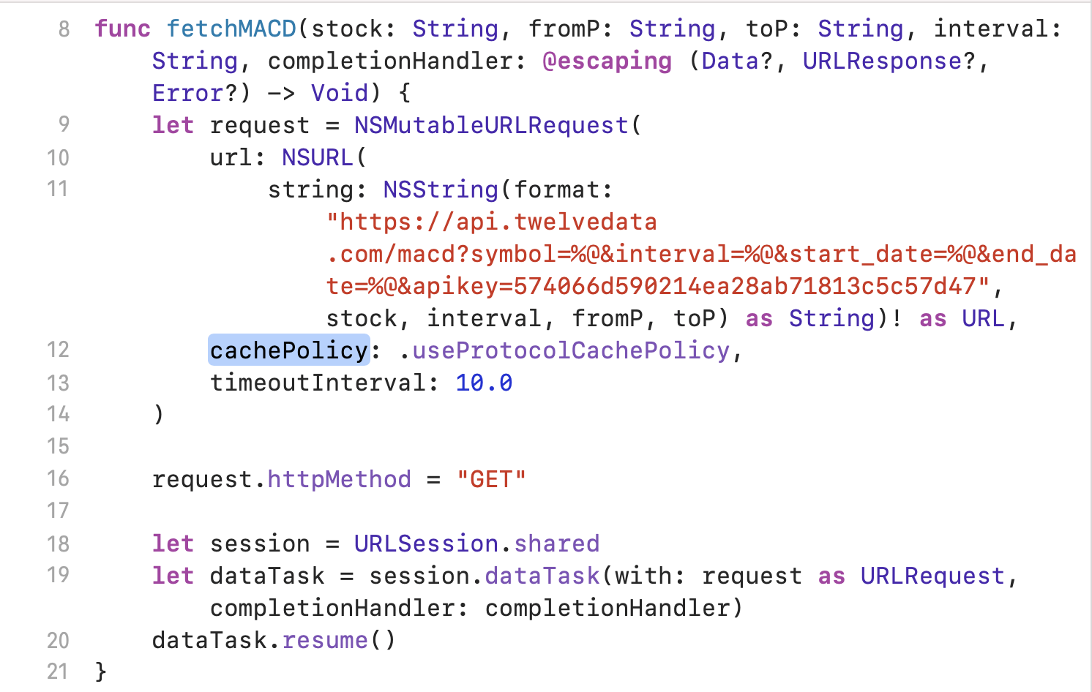
API
Fetching MACD data from twelvedata.com

Slide 11
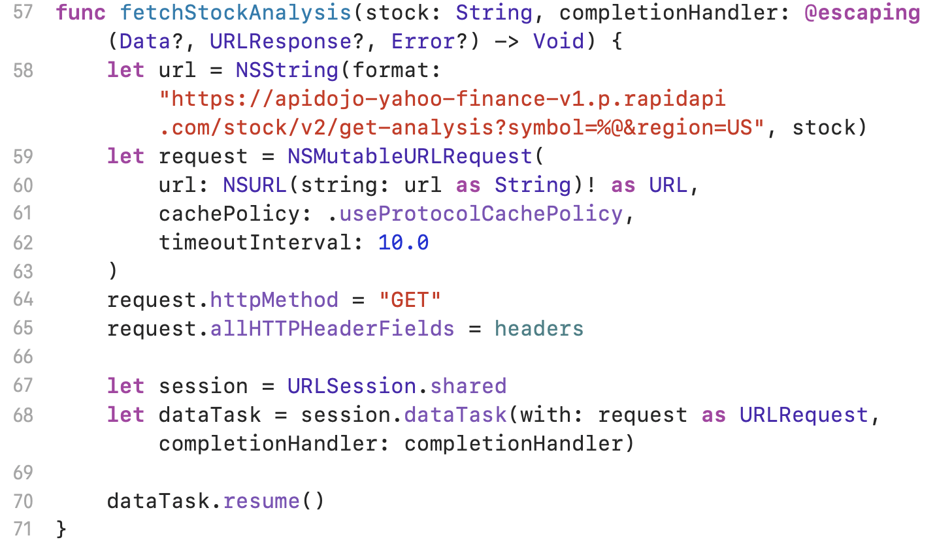
API
Fetching Financial data from Yahoo Finance

Slide 12

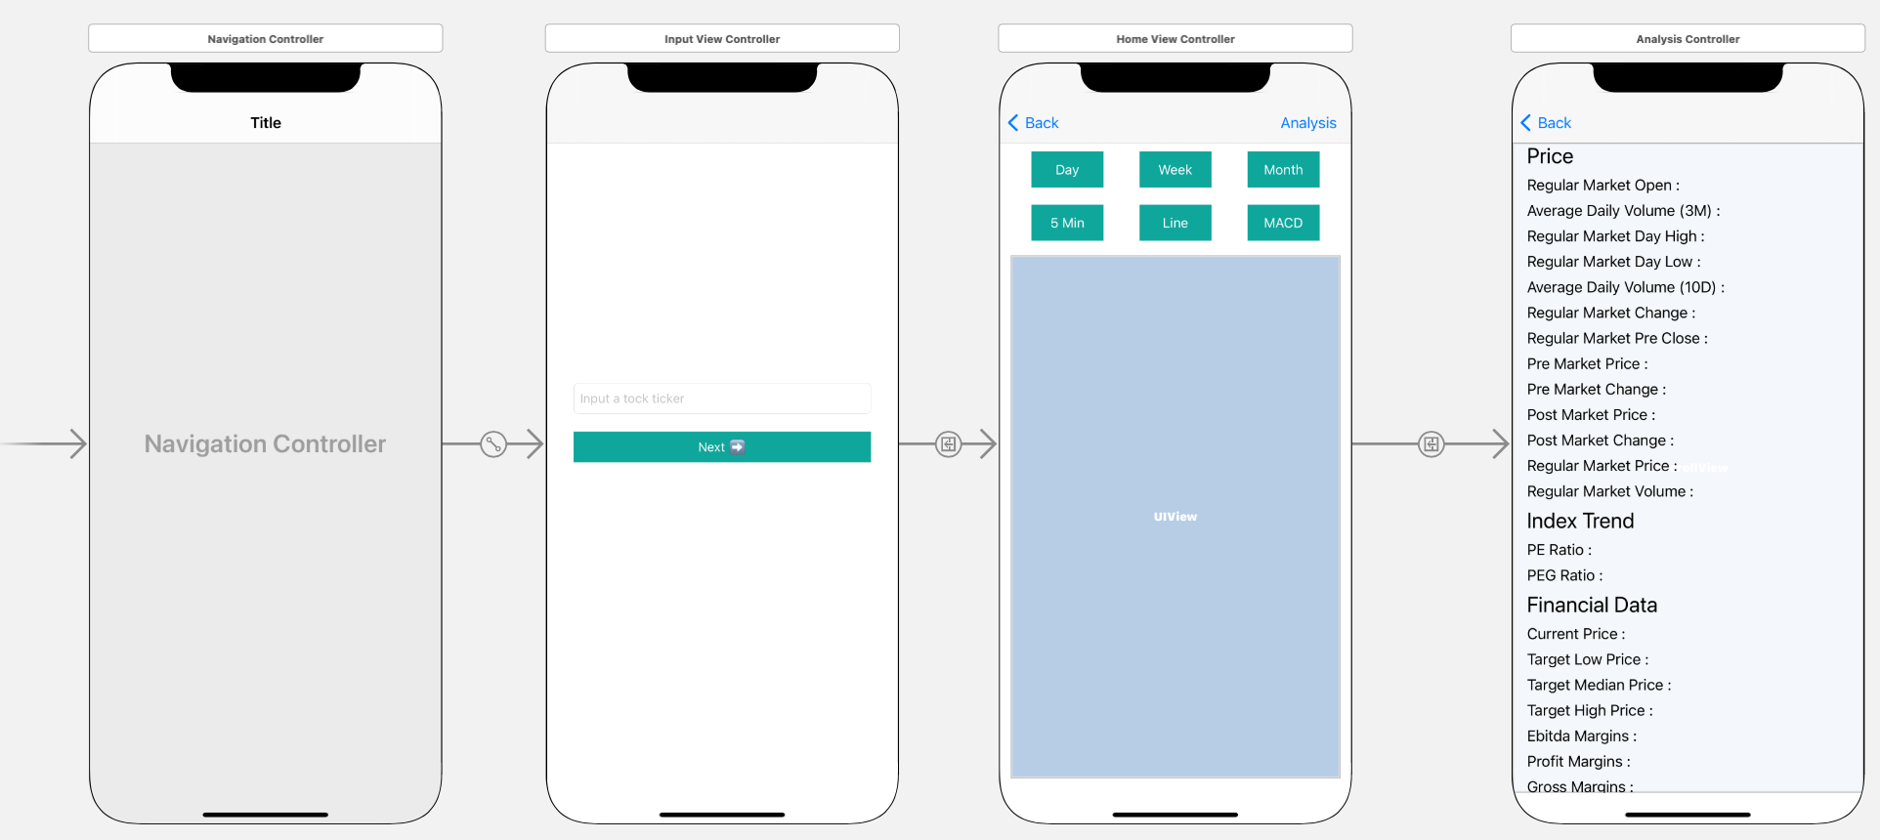
Storyboard

Slide 13
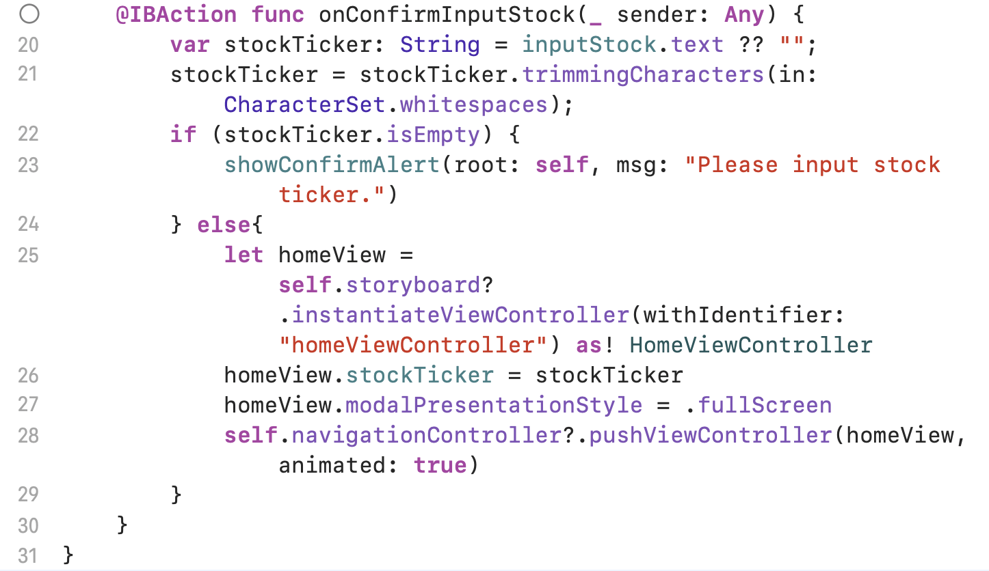
InputViewController
Controller function for the input box in the input view.

Slide 14
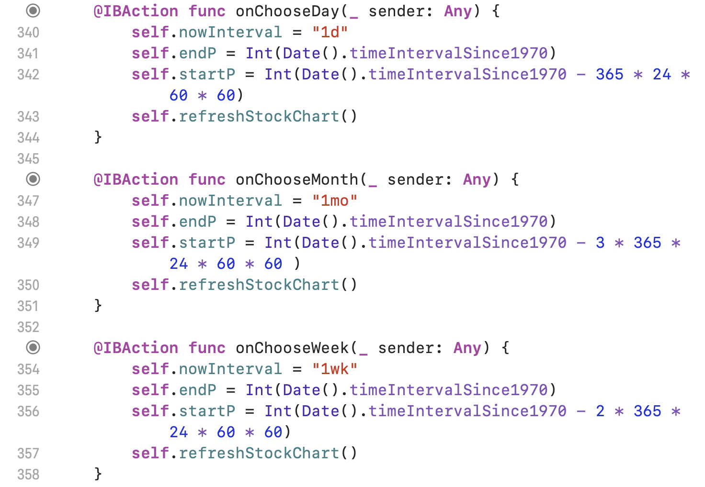
HomeViewController part 1
IBAction functions to switch the time interval in the chart.

Slide 15
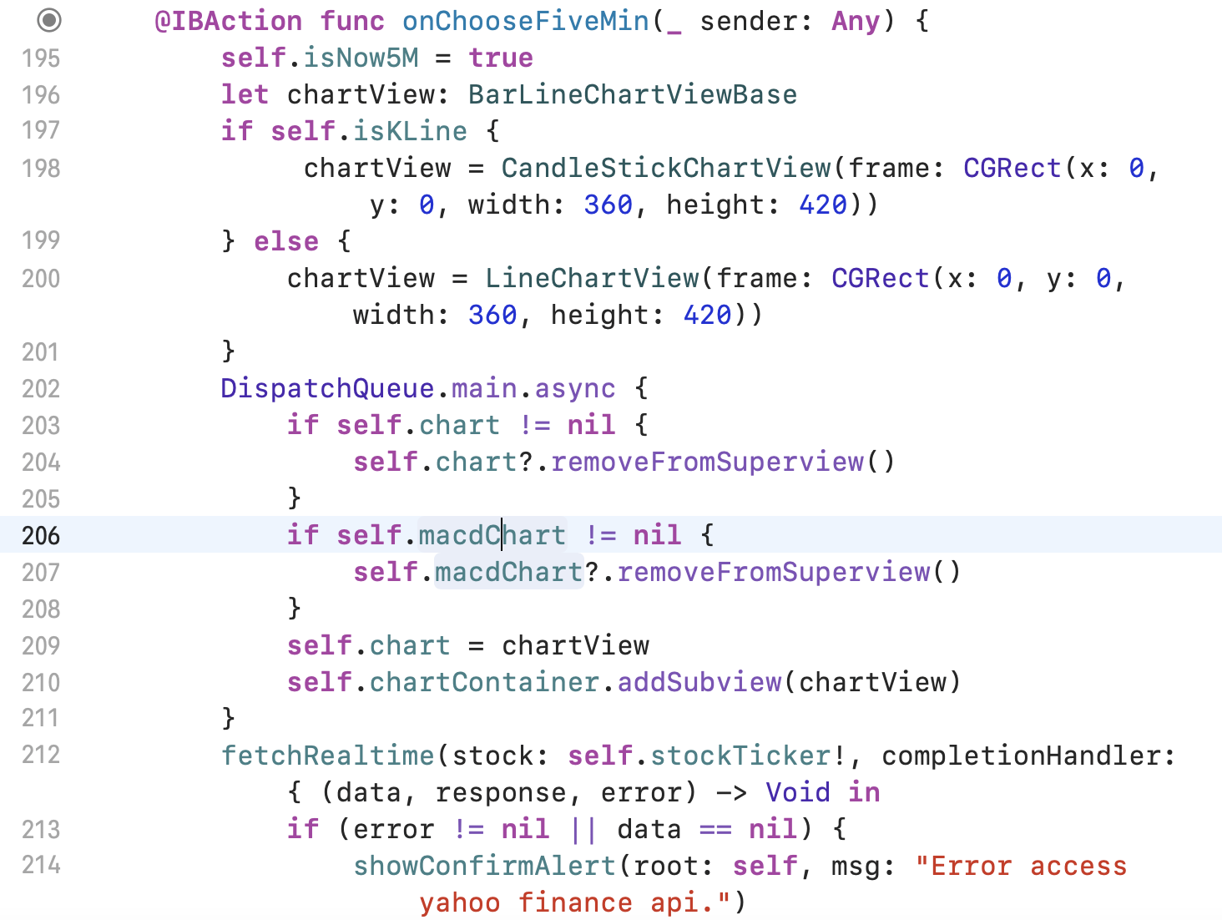
HomeViewController part 2
IBAction function to control the five-minute Chart

Slide 16
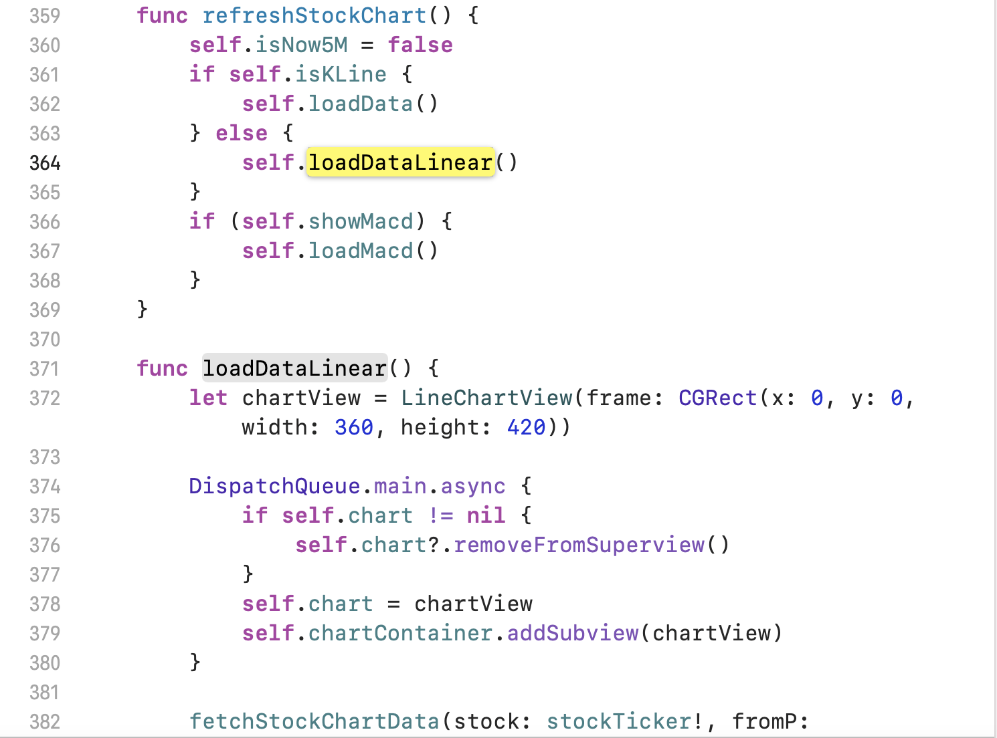
HomeViewController part 3
Loading linear chart.

Slide 17
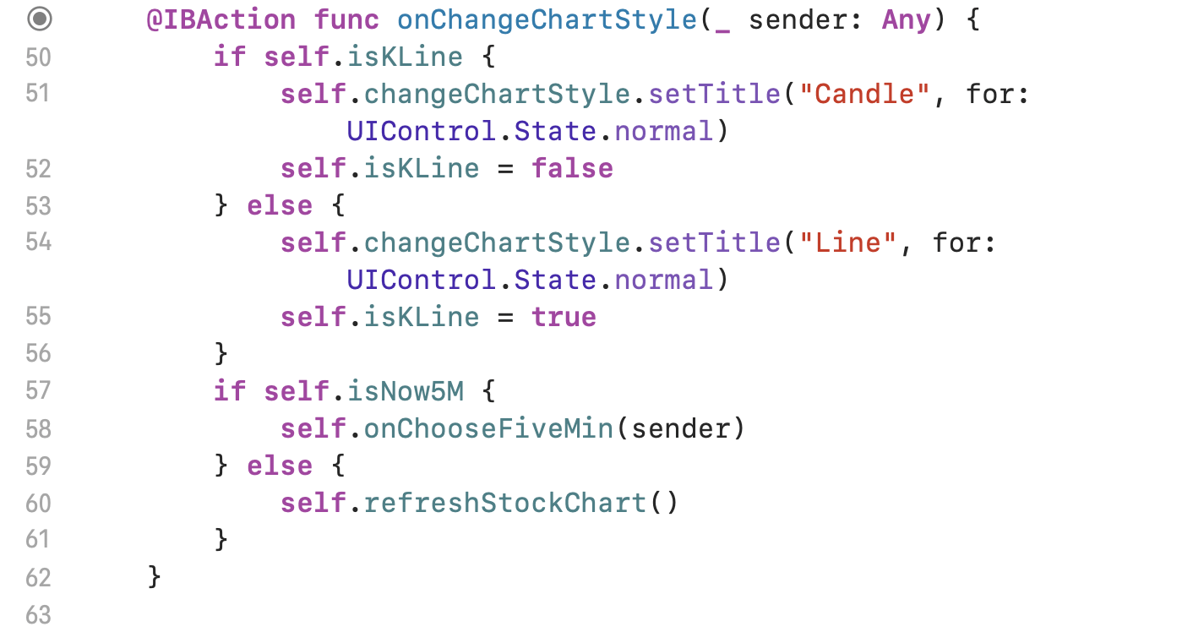
HomeViewController part 4
Function for interchanging between line and candle sticks

Slide 18
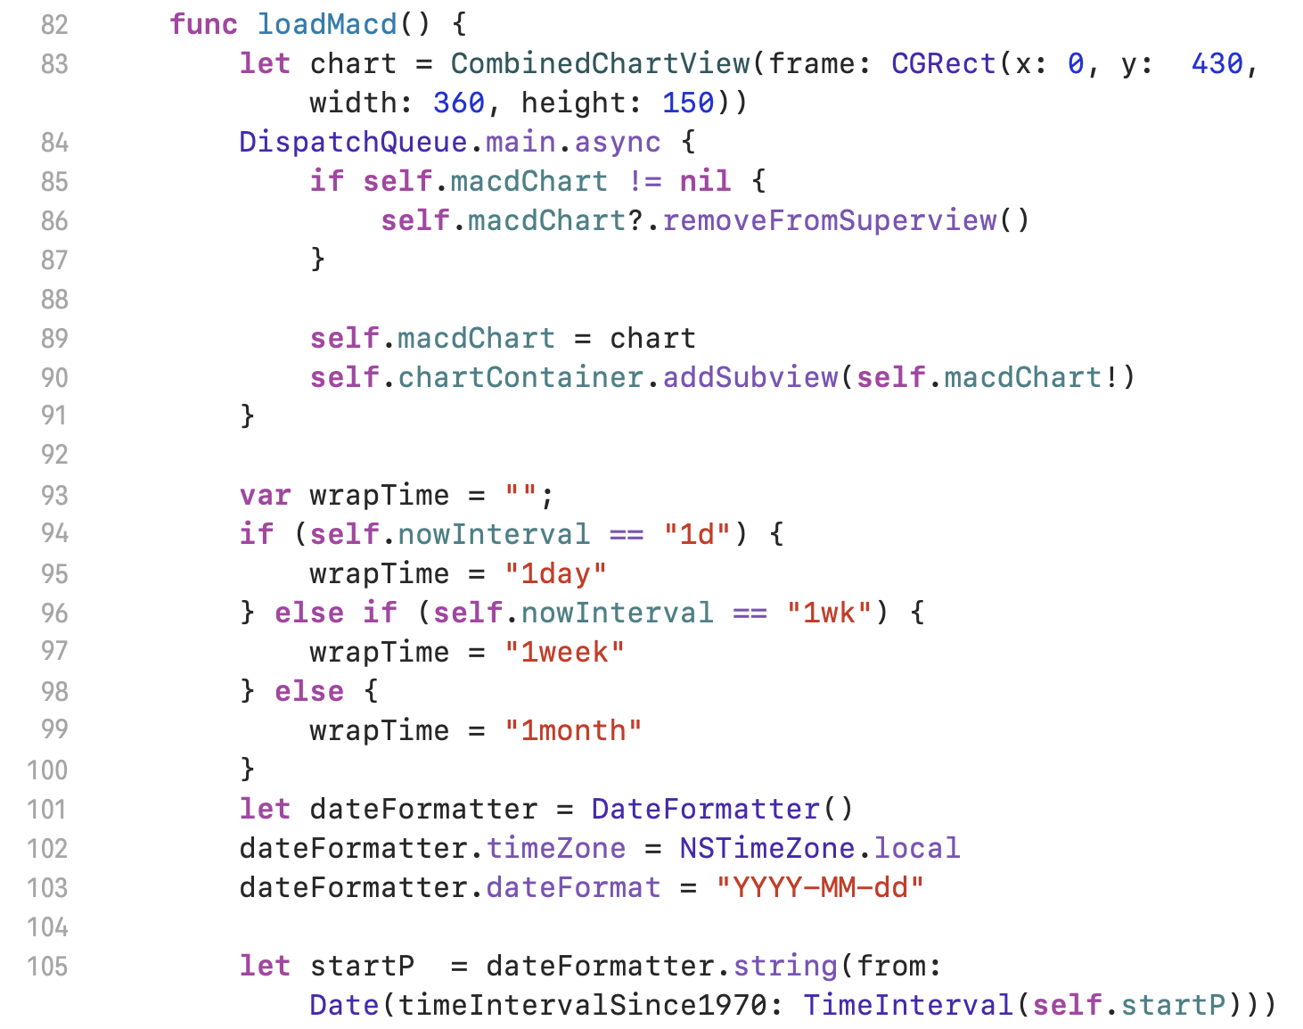
HomeViewController part 5
Function to load MACD indicators.

Slide 19
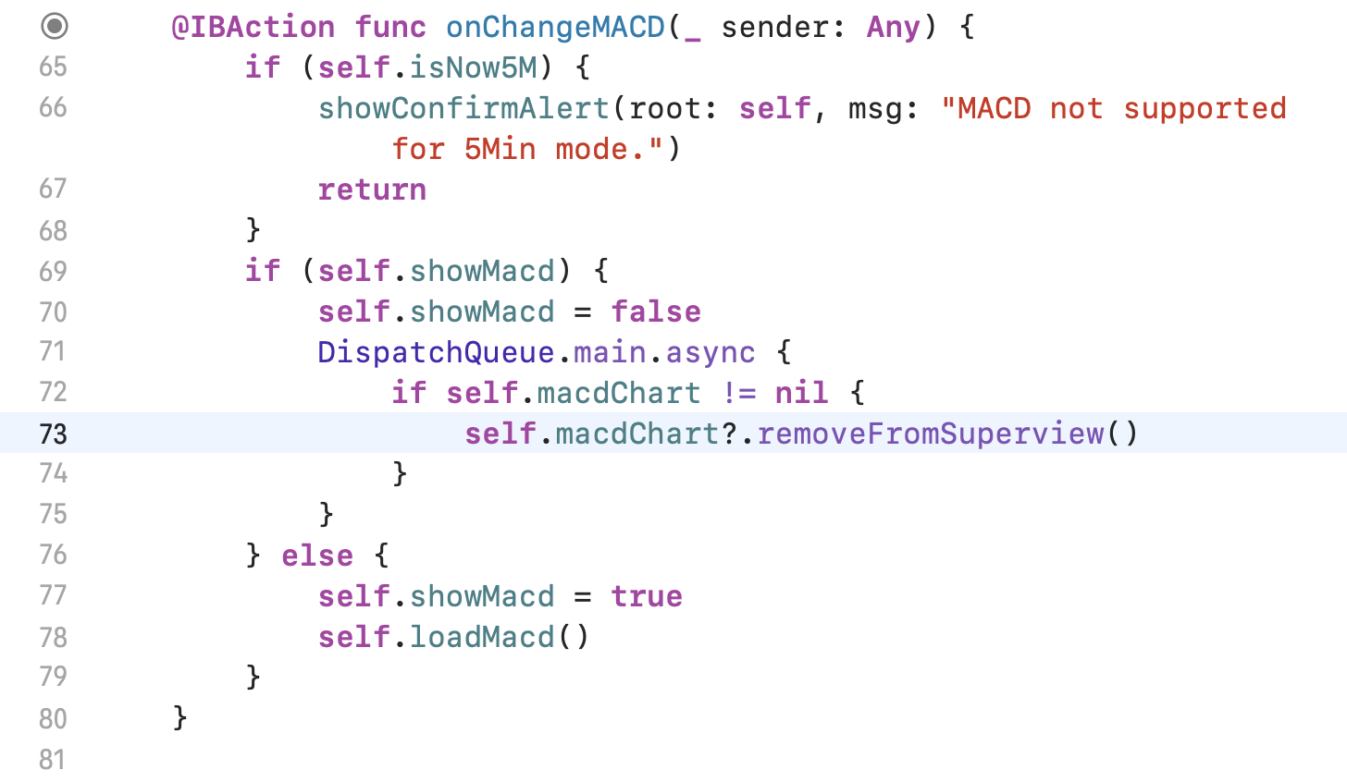
HomeViewController part 6
IBA function to turn on and turn off MACD indicator.

Slide 20
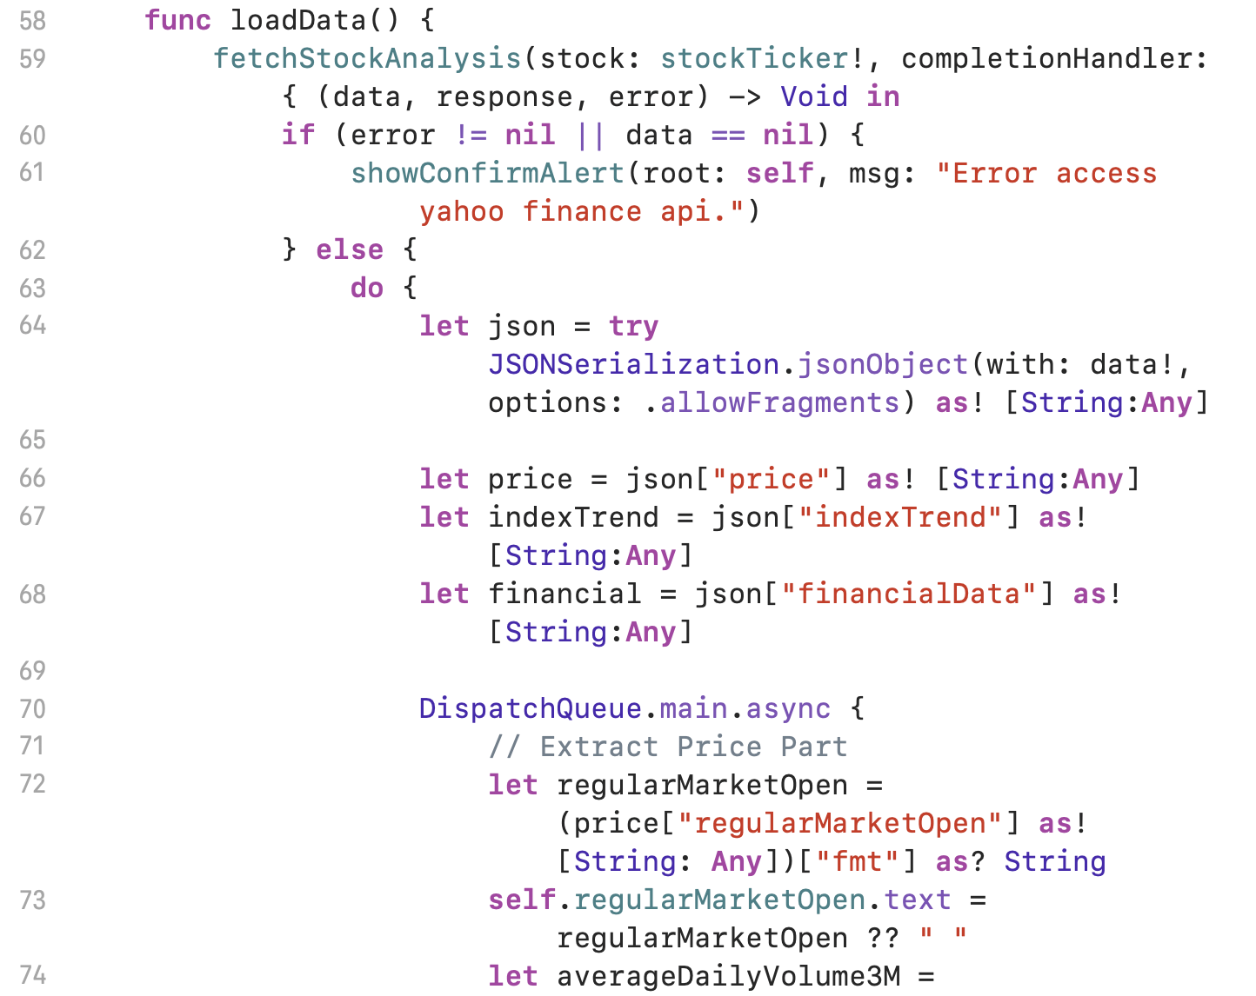
AnalysisController Part 1
The function to access the data and display in the AnalysisView.

Slide 21
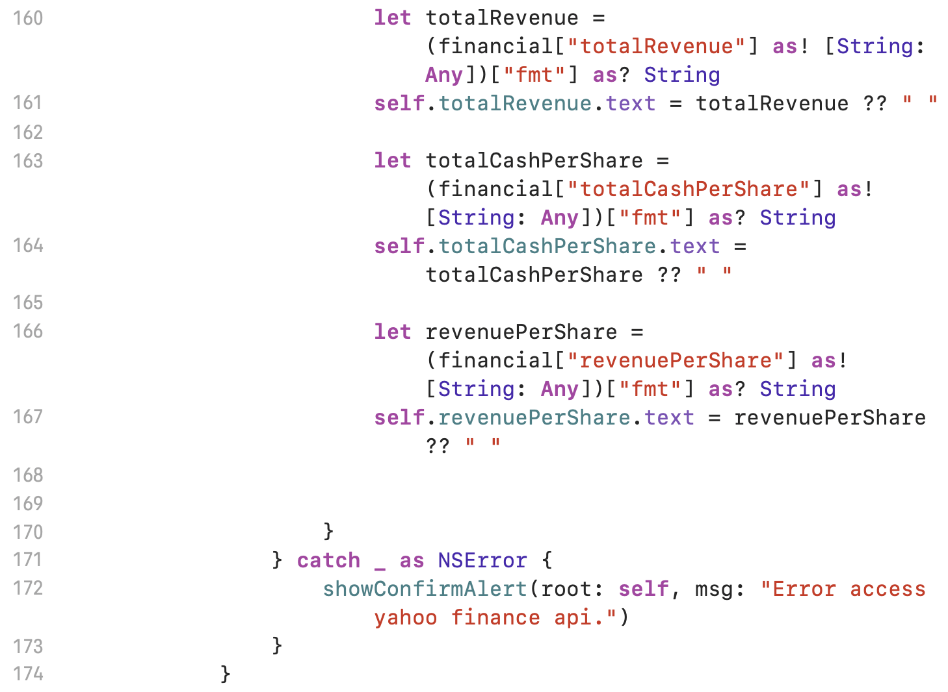
AnalysisController Part 2
The function to access the data and display in the AnalysisView.

Slide 22
Improvement
Refactoring the code.
Adjusting the Auto Layout so the app can display horizontally.
Background picture.
Re-arrange the buttons in Home View

Slide 23
More Stock Data
Paid version.
15 Years Historical Data
Level 2 data
Corporate Actions
Corporate News
Dark pool data
Option contract data
Large option trades

Slide 24
More features to add on
Add Stock price notifications.
Add a screen for user to log in their brokerage account.
Add a screen to show balance of each brokerage account the user has logged in.
Add pie charts to display the portfolio of each user’s brokerage account.
Read the data from each user’s brokerage account and calculate the annual dividend yield.
Analyze the company’s financial information and determine how the company is performing.
Calculate and determine the company’s five-year price prediction base on the financial report and annual percentage yield
Add robot trading feature that can indicate where to enter a position and where to exit.

Slide 25
More features to add on
Paper Trading.
Screener to search for stocks under inputted criteria by user.
Watchlist for user to add their favorite stock ticker.
Instead of five-minute chart, I can add a feature that the user can change the time-specified chart like one-minute chart.

Slide 26
Demonstration
https://youtu.be/rIUszf5Vfr8

